Slide 1


Big Mountain Ski Resort
Evaluating Our Assets & Setting Optimal Ticket Price

Slide 2
Problem Identification
Context
Unclear if resort’s current pricing scheme is maximizing profits
Solution Space
Changing ticket price
& reducing costs
Success Criteria
Increase company revenue by end of next ski season
Data Source
Dataset on ski facilities across the US
Problem Statement: Big Mountain Resort must take better assessment of the worth of its assets to set more competitive prices. This, along with cutting operation costs, should be evaluated to see if they can increase company profits by the end of the next ski season.

Slide 3
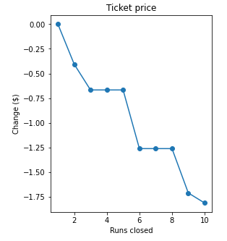
Key Finding & Recommendation
Key Finding: At minimum, the model supports a minimum $4 increase to ticket price, yielding an estimated 7 million in added revenue for the year.
The following changes are also recommended:
Increase vertical drop, add chair lift
Supports additional ticket price increase of $2, ~3.5 Million added revenue
Depends on cost of extra lift
Close at least 1 run
Closure of 1 run has negligible effect on ticket price
Closure of 10 runs drops ticket price projection by $1.75, intermediate numbers should be considered against operation cost

Slide 4
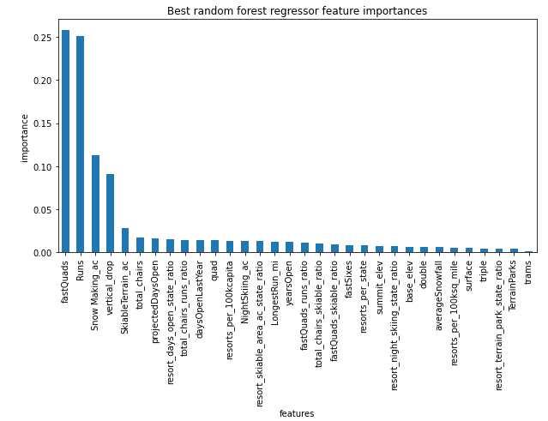
Key Features in Model
The following features are most critical in predicting ticket price in the ski resort market
Fast Quads
Runs
Snow Making Acreage
Vertical Drop

Slide 5
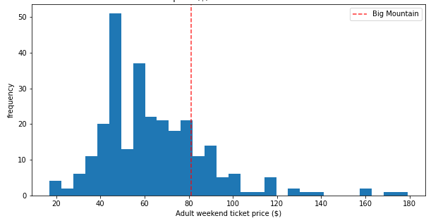
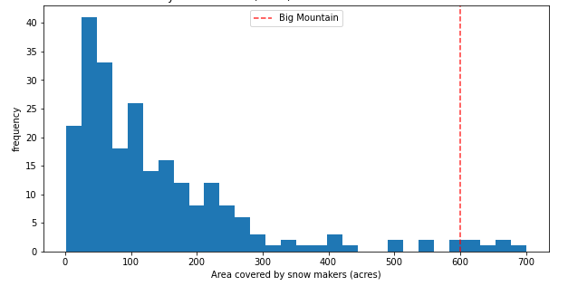
Key Feature: Snow Making Acreage
Big Mountain is a market leader in snow making acreage
Our ticket price position in the market is disproportionate to this feature
This is feature is key in supporting the increase in ticket price
Resort Ticket Price Across Market
Market Quartiles:
47, 60, 78
Big Mountain:
81
Snow Making Acreage Across Market
Market Quartiles:
46, 100, 184
Big Mountain:
600

Slide 6
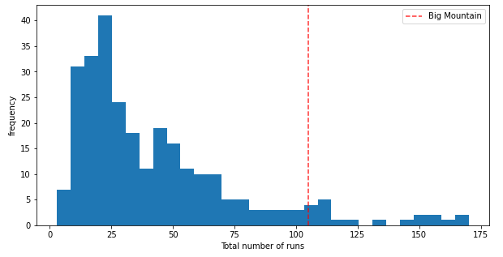
Key Feature: Number of Runs
Few resorts boast more runs than Big Mountain
Though not as drastic, there is a discrepancy between our ticket price and number of runs position in the market
This further drives the projected price increase
Note: An outlier has been removed from this distribution; Aspen Snowmass has 336 runs
Resort Ticket Price Across Market
Market Quartiles:
47, 60, 78
Big Mountain:
81
# of Runs Across Market
Market Quartiles:
19, 32, 55
Big Mountain: 105

Slide 7
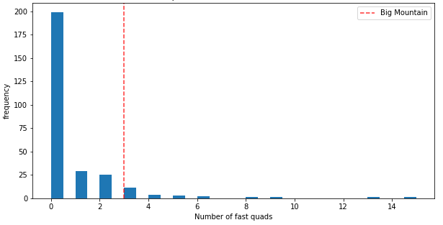
Key Feature: Fast Quads
Big Mountain is one of the few resorts to offer Fast Quads, let alone 3 of them
Some resorts offer far more, but there are fewer of them
Currently, this feature places Big Mountain in the upper tier of resorts
Resort Ticket Price Across Market
Snow Making Acreage Across Market
Fast Quads Availability Across Market

Slide 8
Summary & Conclusion
The model finds a discrepancy between what Big Mountain currently charges, and what the market currently values its facilities at.
Key features include snow making acreage and number of runs, in which Big Mountain is a market leader.
This discrepancy is $4 at absolute minimum, yielding a potential increase in revenue by 7 million next year.
Taking the maximum absolute error of the model, the price could be reasonably increased anywhere from $4 to $25 dollars.
The model has further identified two profitable changes:
Increase vertical drop, add chair lift (after considering cost vs. 3.5 million projected revenue)
Remove at least 1 run

